Slide 1
Tools for this stuff
Tech Stack

Slide 2

What the Hey?
REST API Concepts
Designing the REST API
Securing the REST API
Swagger 2.0 / Open API
API Management

Slide 3
Design REST API
Create Our own REST API
Implement REST API
Error Handling for POST API
REST API Error Handling
API Caching
API Security
API FRAMEWORK

Slide 4
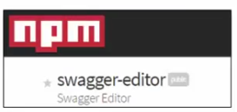





Tools, Platforms
Notes:
----- (CLICK) for our platform we will be using node.js (data-intensive real-time applications that run across distributed devices)
------(CLICK) API Framework ------ most popular framework for implementing node based APIs
----- (CLICK) for writing code we will be using Visual Studio Code IDE
------ (CLICK) Testing Tools ---- Postman --- its available as a free google chrome plug in
----- (CLICK) for the database, we are going to use the hosted site for mongoDB ---- mongoDB is a NoSQL database\
---- (CLICK) for creating the swagger specification we will be using the online version of swagger ------ swagger is the OpenAPI Specification for writing machine-readable interface files for describing, producing, consuming and visualizing RESTful Web Services.

Slide 5

Questions and Answers

